Slide 1
Basic Structure of Computers

Slide 2



Slide 3
Functional Units

Slide 4

Functional Units
Arithmetic
Input
and
logic
Memory
Output
Control
I/O
Processor
Figure 1.1. Basic functional units of a computer.

Slide 6
Input / Output
Input Devices
Output Device

Slide 7
Information Handled by a Computer
Instructions/machine instructions
Govern the transfer of information within a computer as well as between the computer and its I/O devices
Specify the arithmetic and logic operations to be performed
Program
Data
Used as operands by the instructions
Source program
Encoded in binary code – 0 and 1

Slide 8
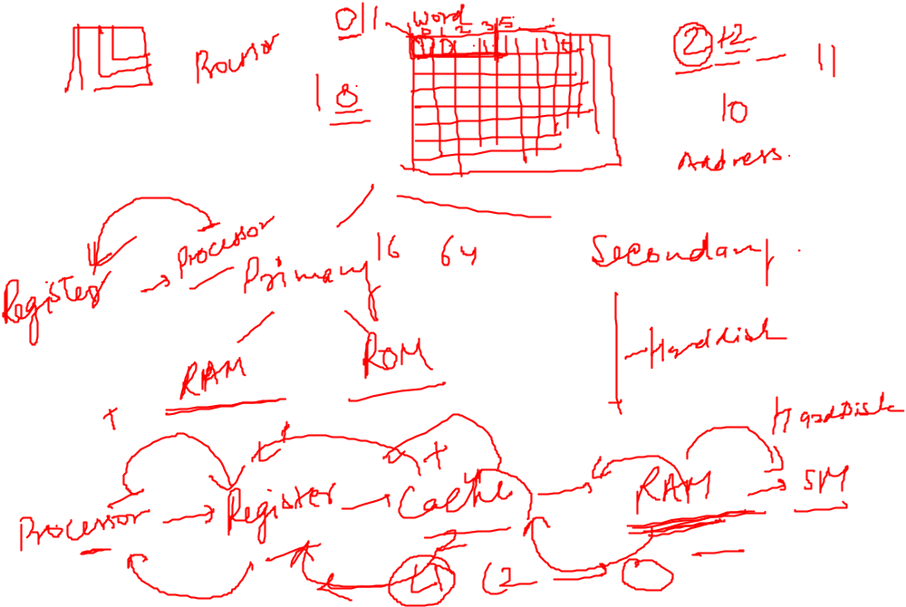
Memory Unit
Store programs and data
Two classes of storage
Primary storage
Fast
Programs must be stored in memory while they are being executed
Large number of semiconductor storage cells
Processed in words
Address
RAM and memory access time
Memory hierarchy – cache, main memory
Secondary storage – larger and cheaper

Slide 9
Arithmetic and Logic Unit (ALU)
Most computer operations are executed in ALU of the processor.
Load the operands into memory – bring them to the processor – perform operation in ALU – store the result back to memory or retain in the processor.
Registers
Fast control of ALU

Slide 10
Control Unit
All computer operations are controlled by the control unit.
The timing signals that govern the I/O transfers are also generated by the control unit.
Control unit is usually distributed throughout the machine instead of standing alone.
Operations of a computer:
Accept information in the form of programs and data through an input unit and store it in the memory
Fetch the information stored in the memory, under program control, into an ALU, where the information is processed
Output the processed information through an output unit
Control all activities inside the machine through a control unit

Slide 11
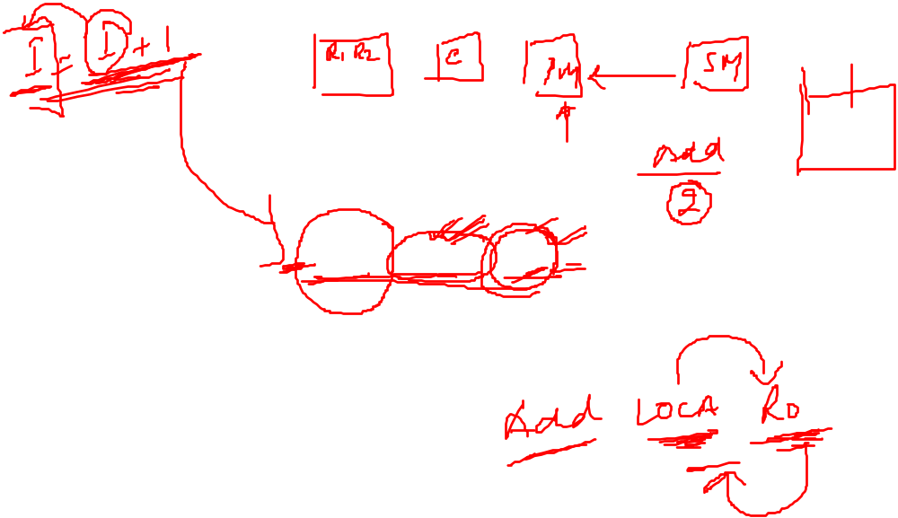
A Typical Instruction
Add LOCA, R0
Add the operand at memory location LOCA to the operand in a register R0 in the processor.
Place the sum into register R0.
The original contents of LOCA are preserved.
The original contents of R0 is overwritten.
Instruction is fetched from the memory into the processor – the operand at LOCA is fetched and added to the contents of R0 – the resulting sum is stored in register R0.

Slide 12

Separate Memory Access and ALU Operation
Load LOCA, R1
Add R1, R0
Whose contents will be overwritten?

Slide 13
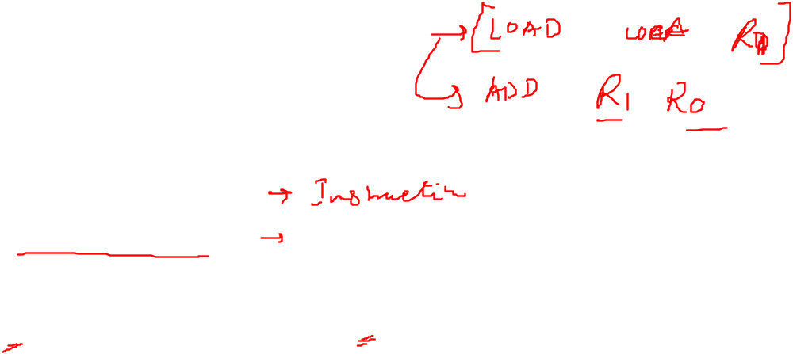
Registers
Instruction register (IR)
Program counter (PC)
General-purpose register (R₀ – R_{n-1})
Memory address register (MAR)
Memory data register (MDR)

Slide 14
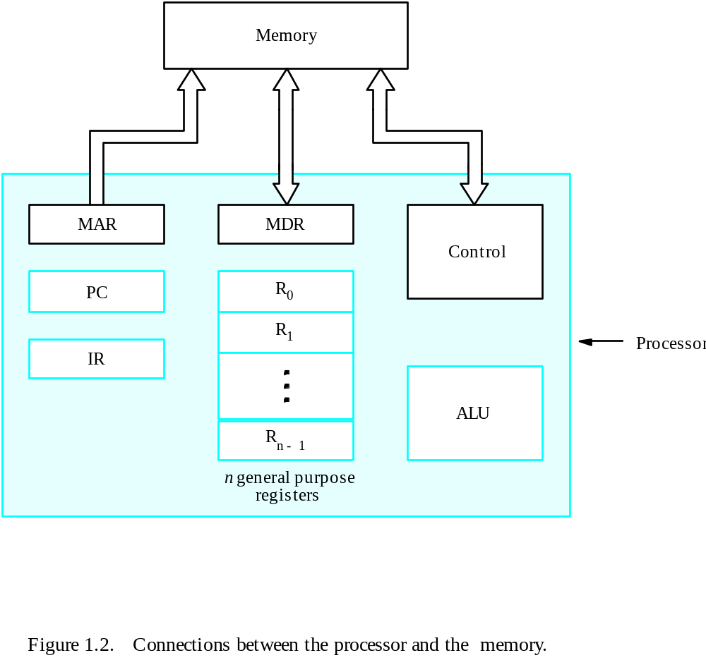


Connection Between the Processor and the Memory

Slide 15
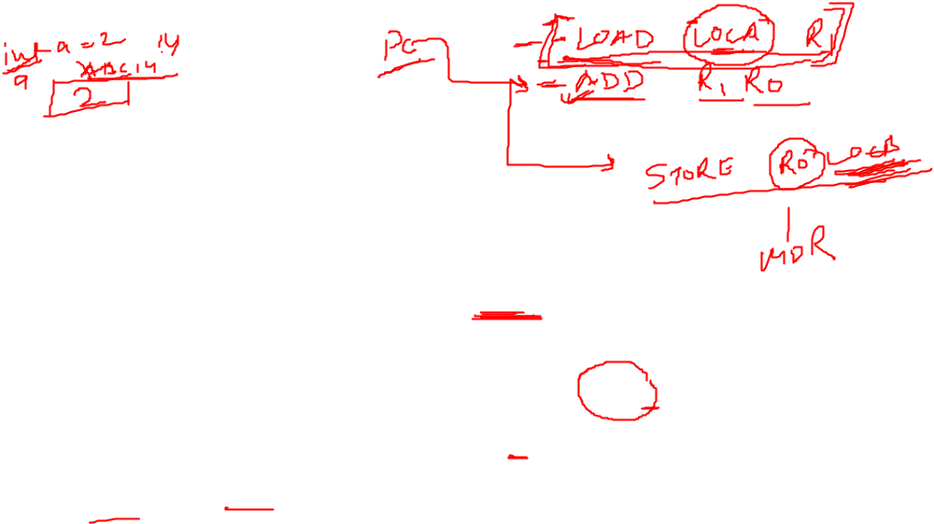
Typical Operating Steps
Programs reside in the memory through input devices
PC is set to point to the first instruction
The contents of PC are transferred to MAR
A Read signal is sent to the memory
The first instruction is read out and loaded into MDR
The contents of MDR are transferred to IR
Decode and execute the instruction

Slide 16
Typical Operating Steps (Cont’)
Get operands for ALU
  General-purpose register
  Memory (address to MAR – Read – MDR to ALU)
Perform operation in ALU
Store the result back
  To general-purpose register
  To memory (address to MAR, result to MDR – Write)
During the execution, PC is incremented to the next instruction

Slide 17
Bus Structures
There are many ways to connect different parts inside a computer together.
A group of lines that serves as a connecting path for several devices is called a bus.
Address/data/control

Slide 18
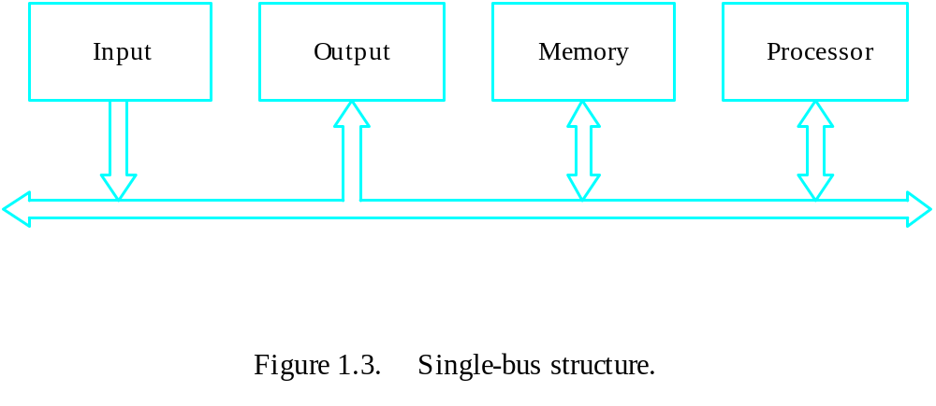

Bus Structure
Single-bus

Slide 19
Speed Issue
Different devices have different transfer/operate speed.
If the speed of bus is bounded by the slowest device connected to it, the efficiency will be very low.
How to solve this?
A common approach – use buffers.

Slide 20
Performance

Slide 21
Performance
The most important measure of a computer is how quickly it can execute programs.
Three factors affect performance:
Hardware design
Instruction set
Compiler

Slide 22
Performance
Processor time to execute a program depends on the hardware involved in the execution of individual machine instructions.
Main
Cache
memory
memory
Processor
Bus
Figure 1.5.
The processor cache.

Slide 23
Performance
The processor and a relatively small cache memory can be fabricated on a single integrated circuit chip.
Speed
Cost
Memory management

Slide 24

Elapsed time: The total time required to execute a program
  is a measure of performance of the entire system.
Processor Time: Time needed by the program when processor is active.

Slide 25
Processor Clock
Clock: processor circuits are controlled by a timing signal called clock
clock cycle: clock defines a regular time interval called clock cycle
Clock rate: R=1/P where p is length of one clock cycle.
The execution of each instruction is divided into several steps, each of which completes in one clock cycle.
Hertz – cycles per second

Slide 26
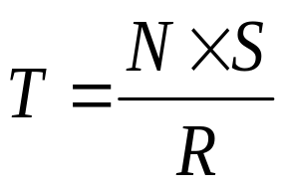

Basic Performance Equation
T – processor time required to execute a program that has been prepared in high-level language
N – number of actual machine language instructions needed to complete the execution (note: loop)
S – average number of basic steps needed to execute one machine instruction. Each step completes in one clock cycle
R – clock rate
Note: these are not independent to each other
How to improve T?

Slide 27
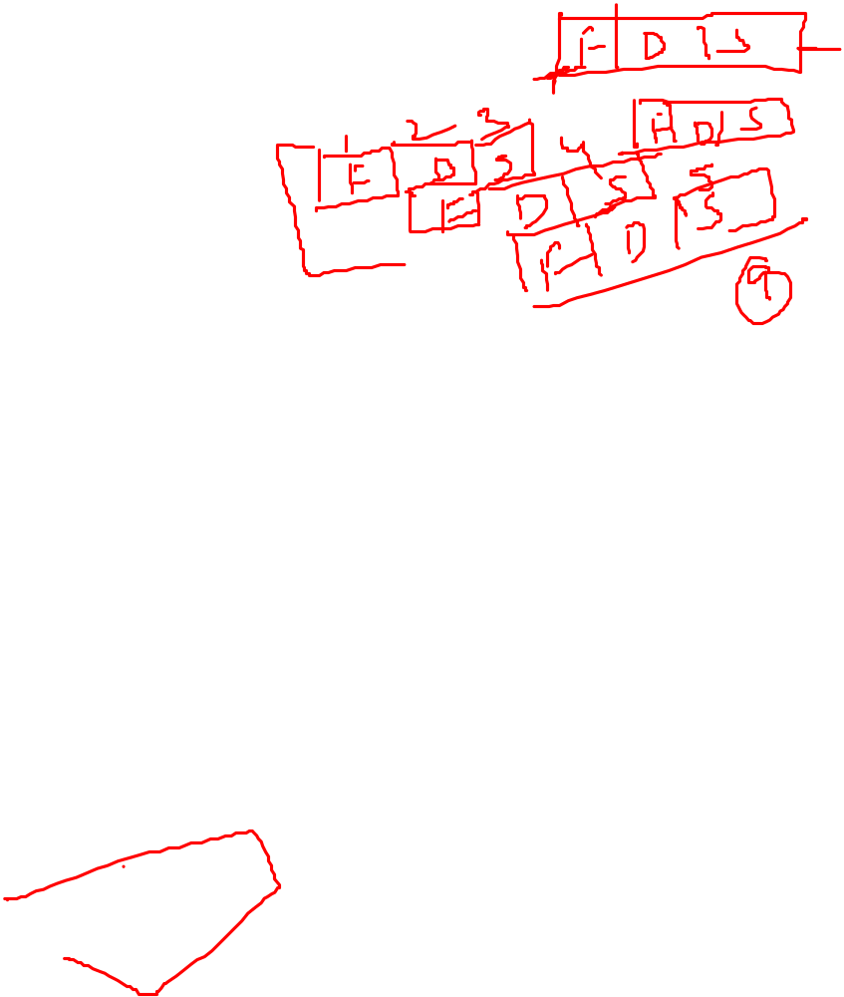
Pipeline and Superscalar Operation
Instructions are not necessarily executed one after another.
The value of S doesn’t have to be the number of clock cycles to execute one instruction.
Pipelining – overlapping the execution of successive instructions.
Add R1, R2, R3
Superscalar operation – multiple instruction pipelines are implemented in the processor.
Goal – reduce S (could become <1!)

Slide 28
Clock Rate
Increase clock rate
Improve the integrated-circuit (IC) technology to make the circuits faster
Reduce the amount of processing done in one basic step (however, this may increase the number of basic steps needed)
Increases in R that are entirely caused by improvements in IC technology affect all aspects of the processor’s operation equally except the time to access the main memory.

Slide 29
Multiprocessors and Multicomputers
Multiprocessor computer
Execute a number of different application tasks in parallel
Execute subtasks of a single large task in parallel
All processors have access to all of the memory – shared-memory multiprocessor
Cost – processors, memory units, complex interconnection networks
Multicomputers
Each computer only have access to its own memory
Exchange message via a communication network – message-passing multicomputers

Slide 30

CISC and RISC
Tradeoff between N and S
A key consideration is the use of pipelining
S is close to 1 even though the number of basic steps per instruction may be considerably larger
It is much easier to implement efficient pipelining in processor with simple instruction sets
Reduced Instruction Set Computers (RISC)
Complex Instruction Set Computers (CISC)

Slide 31
Compiler
A compiler translates a high-level language program into a sequence of machine instructions.
To reduce N, we need a suitable machine instruction set and a compiler that makes good use of it.
Goal – reduce N×S
A compiler may not be designed for a specific processor; however, a high-quality compiler is usually designed for, and with, a specific processor.

Slide 32

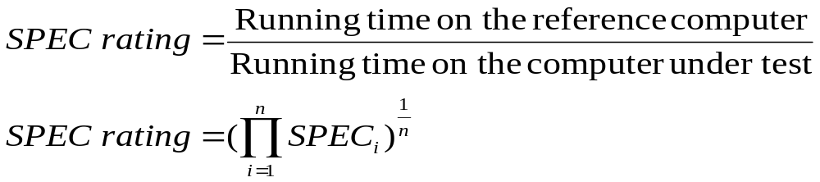
Performance Measurement
T is difficult to compute.
Measure computer performance using benchmark programs.
System Performance Evaluation Corporation (SPEC) selects and publishes representative application programs for different application domains, together with test results for many commercially available computers.
Compile and run (no simulation)
Reference computer

Slide 33

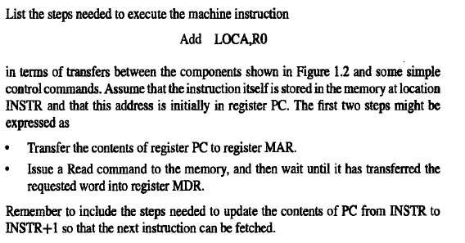
Problem: 1.1

Slide 34
Solution
• Transfer the contents of register PC to register MAR
• Issue a Read command to memory, and then wait until it has transferred the requested word into register MDR
• Transfer the instruction from MDR into IR and decode it
• Transfer the address LOCA from IR to MAR
• Issue a Read command and wait until MDR is loaded
• Transfer contents of MDR to the ALU
• Transfer contents of R0 to the ALU
• Perform addition of the two operands in the ALU and transfer result into R0
• Transfer contents of PC to ALU
• Add 1 to operand in ALU and transfer incremented address to PC

Slide 35
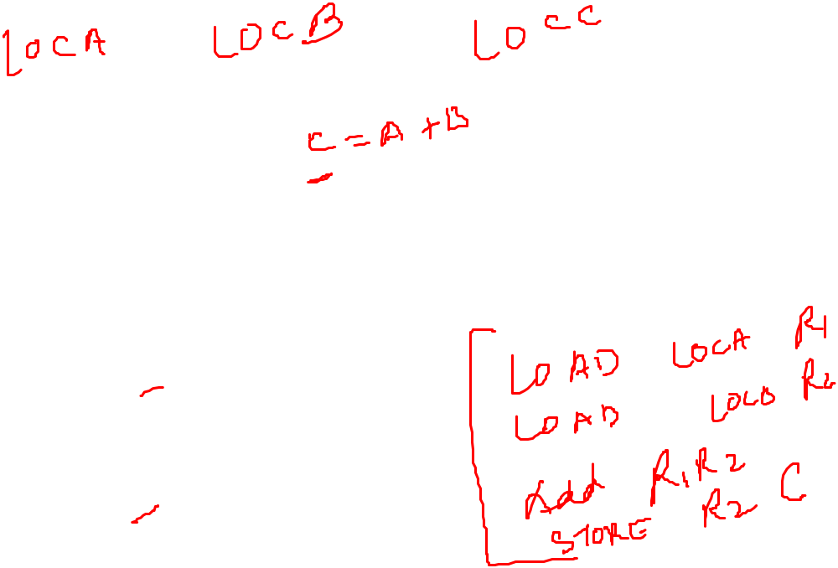
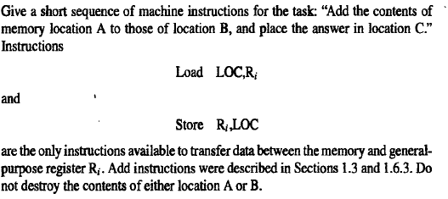
Problem 1.3 (a)

Slide 36
Solution
Load A,R0
Load B,R1
Add R0,R1
Store R1,C

Slide 37
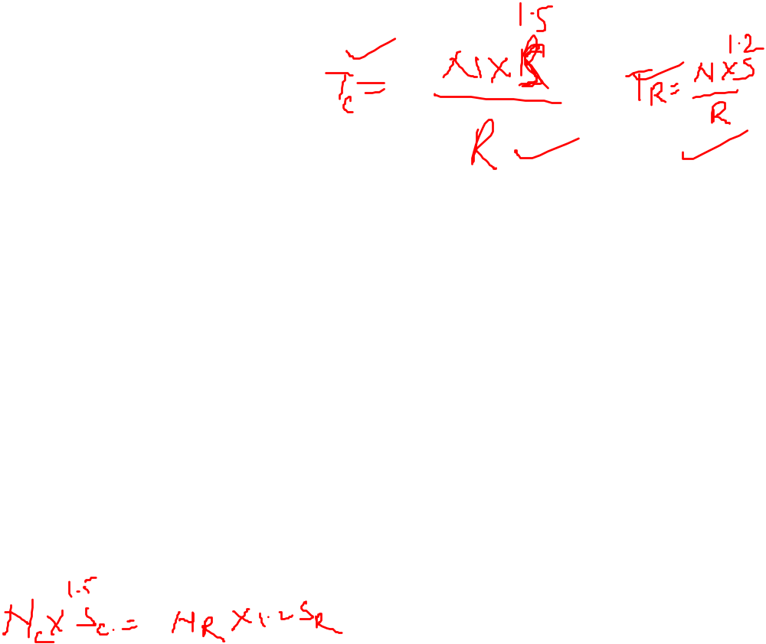
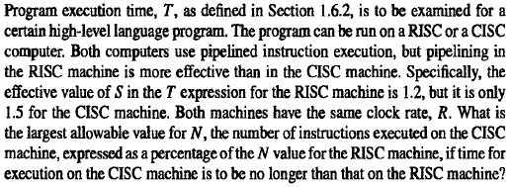
Problem 1.4 (a)

Slide 38
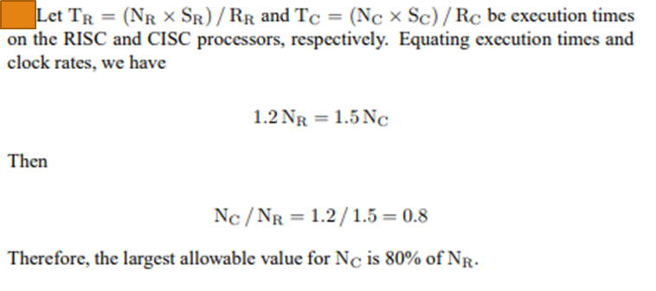

Solution

Slide 39
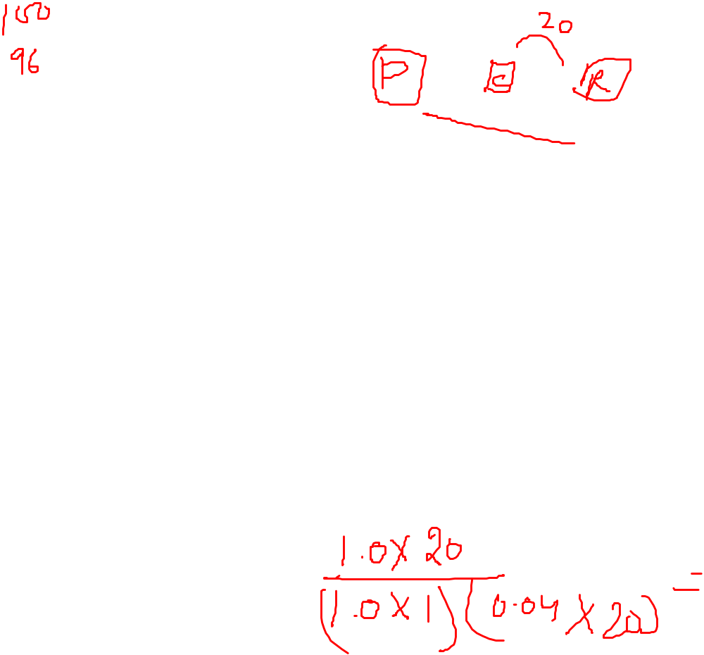
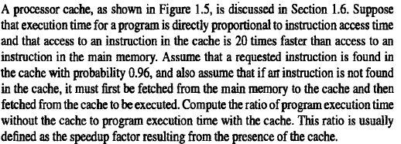
Problem 1.6 (a)

Slide 40

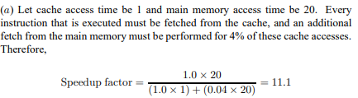
Solution

